Slide 1
American Government and Economic Systems

Slide 2
This is not a course about . . .
dates, facts, and figures that must be memorized and recited, only to be forgotten 1 day later.
balancing a checkbook, following stocks, and business management.
learning economics as a “dismal science” which would include equations, and an abundance of charts and graphs. There will be some math but this course will not be math driven.
influencing your political views in one way or another.
simply learning an economic unit followed by a unit on government followed by an another unit on economics, and so on and so forth.

Slide 3
So, what is this course about?
The goal is to learn both economics and politics in a manner that combines both courses. It is the desire of the teacher that students apply their understanding of economics to politics and their knowledge of our governmental system to the economy.
This course is about people.
We will look at people as individual decision makers and investigate how individuals form a society.

Slide 4
This course is also about . . .
learning how to collect information and making our own interpretations.
looking at individual decisions and attempting to understand why people act a certain way.
learning economics in a manner that is entertaining and enlightening.
influencing you to become an active decision maker.
blending both courses together in a manner that allows you to understand the world around and yourself.
integrating other subjects including game theory, physics, biology, ecology, math, statistics, history, etc.

Slide 5
The Key Understandings of the Course.
As this course progresses students should be able to confidently state the following.
I understand that . . .
individuals have self-worth and natural rights.
the individual is the basic unit of decision-making whether it is economic, social, or political.
individual decision making involves making trade-offs, thinking on the margin, and responding to incentives.
voluntarily exchanges are made between individuals because they believe that they will be mutually benefited.
decisions will result in both private and social impacts.
the manner in which individuals form collective decisions defines the economic and political systems.
collective decisions are restricted by the same parameters that apply to individual decisions.

Slide 6
How will we learn this material?
The teacher will assist and facilitate the learning process.
Students will be responsible to do much of the preliminary learning at home. Online materials such as course readings, supplemental readings, and daily lessons will be posted on the school wires site.
By the time that students enter the classroom the teacher expects that they have already completed the preliminary activities. The classroom is where students can expect clarification and enrichment of the material.
In class, students can expect to be actively engaged in discussion, debates, simulations, game theory, games, Q and A sessions, and other activities that are designed to supplement the learning experience.

Slide 7
A word about models.
In the most general sense, a model is anything used in any way to represent anything else. Some models are physical objects, for instance, a toy model which may be assembled, and may even be made to work like the object it represents. Whereas, a conceptual model is a model made of the composition of concepts, that thus exists only in the mind. Conceptual models are used to help us know, understand, or simulate the subject matter they represent.
Almost every simulation, activity, or game in this class is intended to serve as a model. The purpose of the models is to present a scaled-down version of the real world.

Slide 8
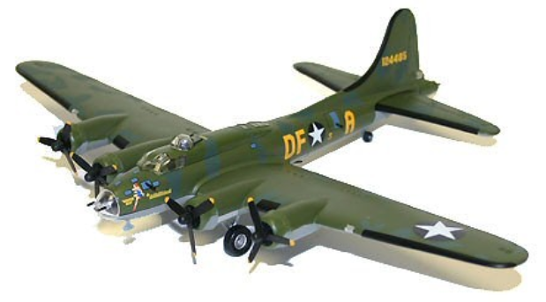
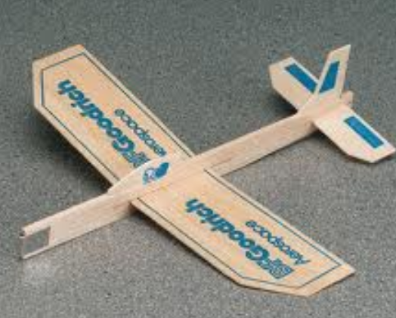
A word about models.
Which is the better model?

Slide 9
A word about models.
The question is impossible to answer without know the intentions of the simulation or model.
In the examples above, if the intention is to locate the weapons, the distances, and markings then the model on the left would probably be more helpful. But what if the intention was to see how the plane would react to cross winds or head winds? The model on the right may provide better information.

